Slide 1
Your Health and Social Care Champion
Giving patients a voice and shaping local services

Slide 2
What is Healthwatch Sefton?
Healthwatch is here to give children, young people and adults a powerful voice both locally and nationally
Healthwatch Sefton will work to help people get the best out of their local health and social care services whether it’s improving them today or helping to shape them for tomorrow.
Our role is to ensure their views are taken into account by service providers – and their commissioners
We are part of a national network of local Healthwatch
Notes:
152 Healthwatch’s across England
There is a Healthwatch England
Funded via the department of health – led by volunteers
The Chair of the organisation is Bill Bruce
We took over from Sefton Local Involvement Network in 2013.

Slide 3
What can Healthwatch Sefton do?
Give local people and communities a stronger voice to influence how health and care services are provided within Sefton
Have the power to enter and view services
Influence how services are set up and commissioned by having a seat on the local health and wellbeing board
Produce reports to influence the way services are designed and delivered
Provide information, advice and support about local services
Pass information, recommendations and reports to Healthwatch England and the Care Quality Commission
Notes:
There is a Healthwatch in every borough across England 152 and Healthwatch England
As a Healthwatch we can conduct enter and view visits on NHS services including hospital wards, NHS care homes, GP surgeries – either announced or unannounced
Reports – e.g. reports have included GP access, Continence services, Hospital trust reports, Covid report (Look on our website for all our reports)

Slide 4
Where will my feedback go?
First of all, all feedback is anonymous so no personal details are shared.
Feedback is sent directly to the reviewed service e.g., your surgery or hospital.
For example, when you leave feedback on our website under the ‘Share your experiences’ tab, search for the service you want to review and type your review. Then, it comes through to me for moderation and approval. Once it goes live, the surgery will get an email alert every Monday letting them know feedback has been left. Your feedback is taken to the service provider you have reviewed.
Your feedback can also be used to contribute to reports on wider service improvements. You can see this in action by looking at previous reports on our website.

Slide 5
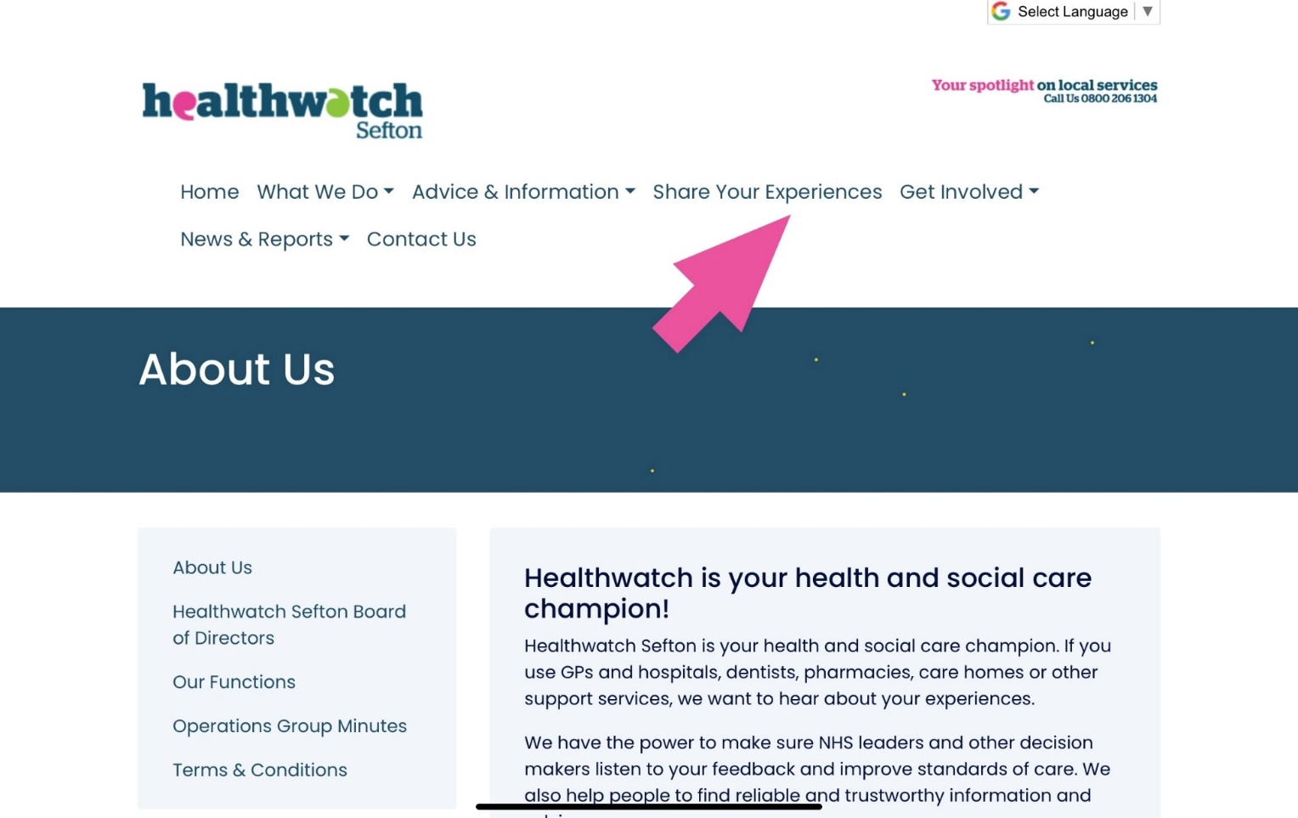
Leaving feedback on the website
Via the Feedback Centre on our website
People can leave their reviews of the services anonymously
Notes:
As mentioned our role is to listen to Sefton residents and the people who access the services. We feed any emerging health and social care themes to providers and commissioners of services…..
People can leave feedback on our website. Works in a similar way to TripAdvisor where people can rate the service based on staff attitude, treatment, waiting times etc
It’s easy and quick to do. Also available in paper format ( copies available will have to see what we could do as no office access)
Any queries you can contact any member of the Healthwatch team.

Slide 6
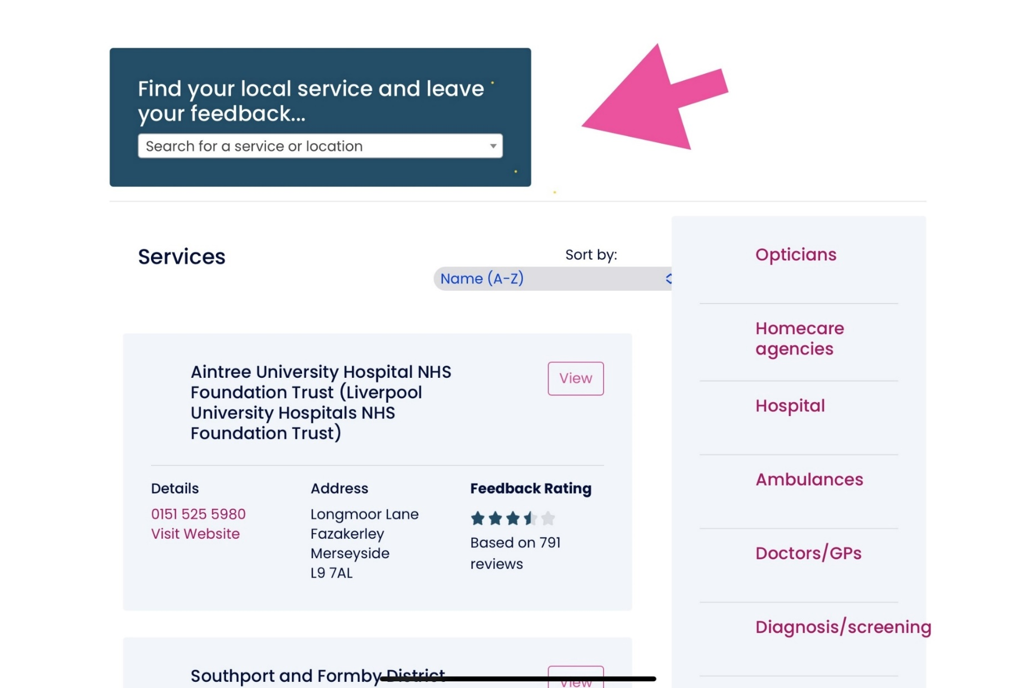

Slide 7
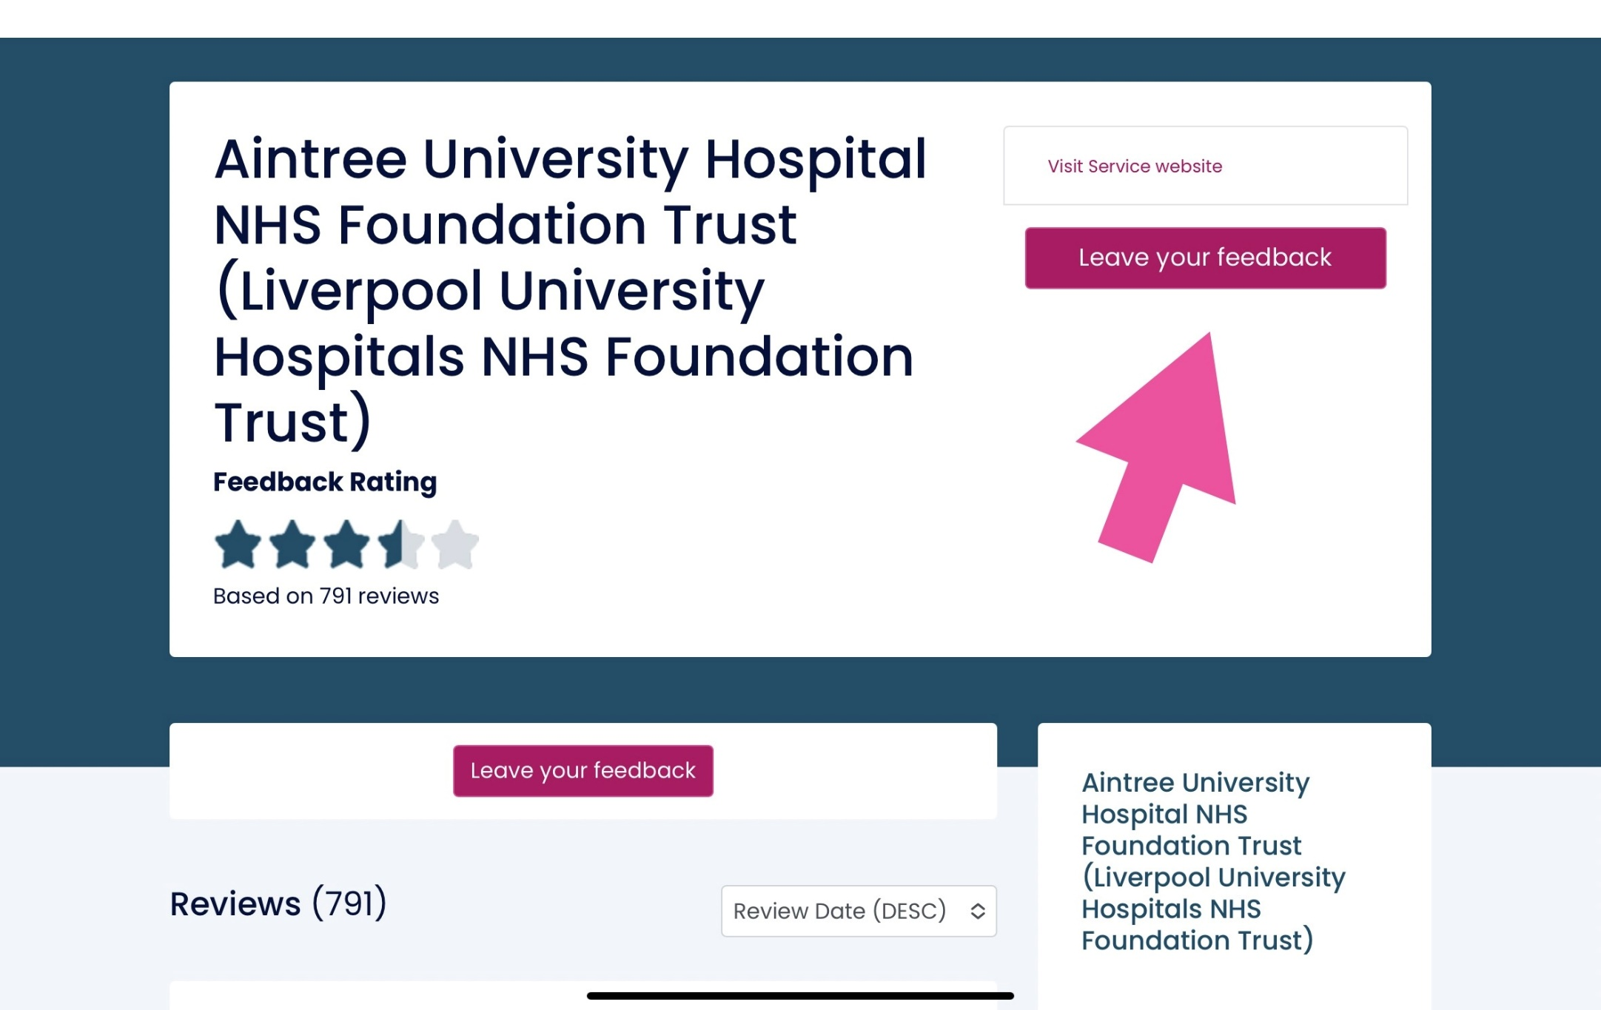

Slide 8
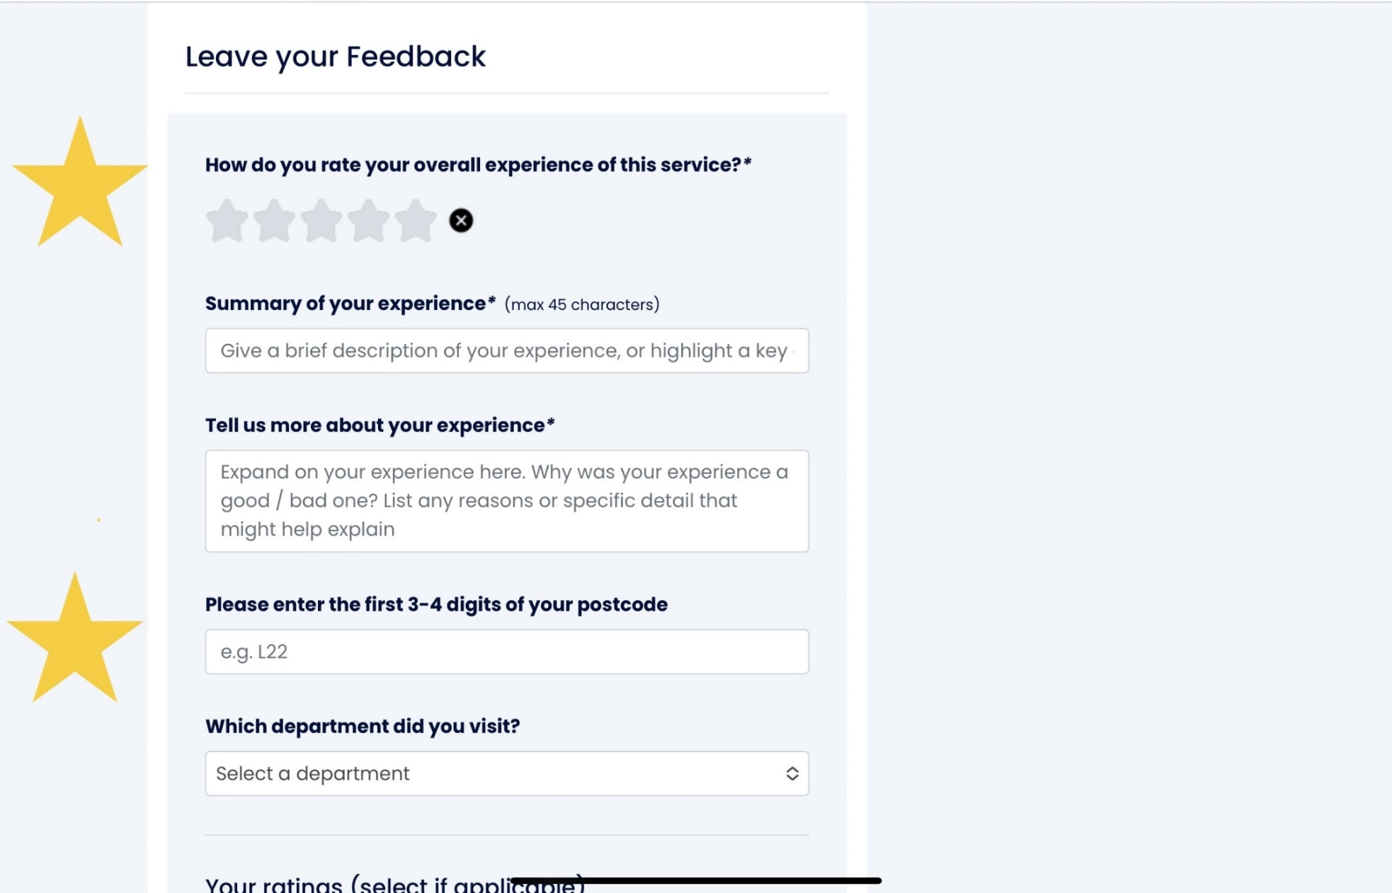

Slide 9
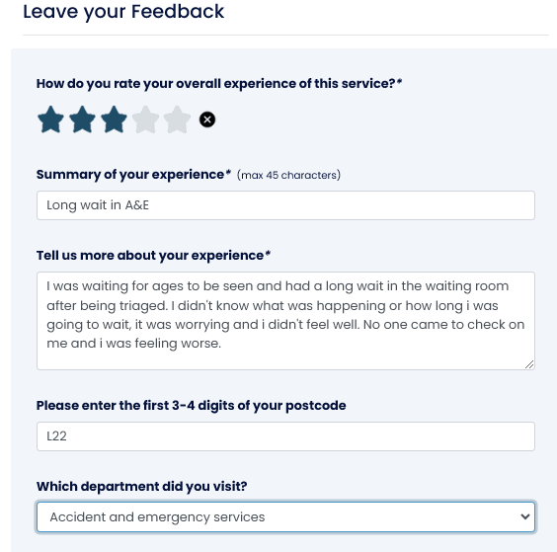

Slide 10
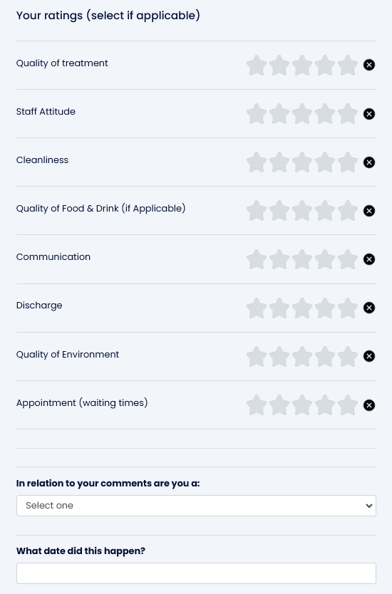

Slide 11
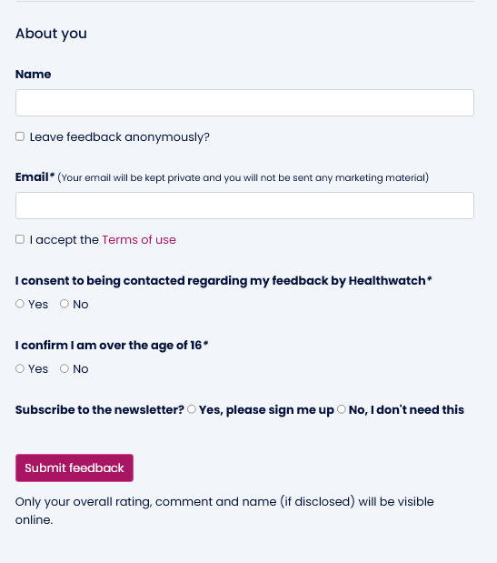

Slide 12
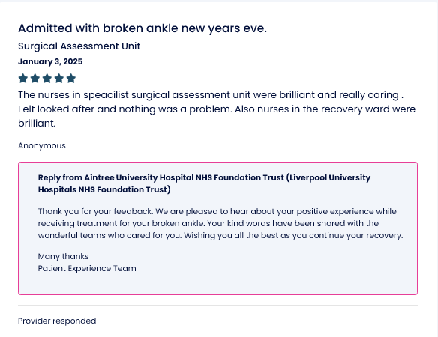

Slide 13
Signposting & Information Service
As an independent organisation we can signpost you to a variety of services, helping you to navigate your own healthcare needs.
Freephone number - 0800 206 1304
Email: info@healthwatchsefton.co.uk
Opening Hours: Monday to Friday
Signposting & Information Officer: Amanda Williams
Notes:
Any queries on our signposting service please refer to Dawn on the contact details in the presentation.
Our other services include:
the Signposting and Information service is one of our statutory functions and it would be beneficial for GP’s to use the service and consider this as part of their wider signposting and social prescribing work.
Most of the calls we get are people looking to register with an NHS dentist – mainly in the Southport area
We can also give people emergency dentist details if they are in a lot of pain and needing treatment urgently
Dawn, our information and signposting officer, deals with calls from people looking for help with many health and social care issues including mental health, social care queries or making an NHS complaint – more on this next

Slide 14
Healthwatch Sefton Independent Complaints Advocacy
We can help people to make their complaint to the NHS
An NHS complaint might include something that happened during care or treatment at:
hospital
your GP
the dentist
the pharmacy
the optician
an NHS-funded care home NHS complaint
Contact the Healthwatch Sefton Signposting & Information Officer for a self-help pack, and referral.
Notes:
Please refer to Dawn our signposting officer if you have any queries / questions on the advocacy service.
They speak to our Information and Signposting Officer (ISO), Dawn, who triages their complaint and discusses their options with them
The client is then separated in to one of two Tiers, Tier 1 or Tier 2
Tier 1 can be anything ranging from:
Phone numbers or complaint information being given
Sending a Self Help Information Pack (SHIP) to the client and making a 14 day call back (if required)
If a 14 day call back is required, Dawn will discuss if the SHIP was helpful or if any further support is needed
If further support is needed, Dawn will take further details and allocate the case for Advocacy (Tier 2
Tier 2 – is where a formal complaint is identified and an advocate is available for support.

Slide 15
Thank You
Any Questions?
Healthwatch Sefton
Free Phone 0800 206 1304
Text Service: 07434 810438
Email: info@healthwatchsefton.co.uk

